Slide 1
計算機概論實習
Week7 (2020/10/13)
副程式(Function)
Lab: EC 118
助教:
陳作源 russchen.cs08g@nctu.edu.tw
陳彥銨 my91015.cs08g@nctu.edu.tw
鄭智仁 king601012003.cs08g@nctu.edu.tw

Slide 2
Why we need Function?
Modularize the program, reduce code length and writing time.
Easier to debug.
Easier to maintain and update .
More structured and organized .
Easier to read .
The developed program can be reused .

Slide 3
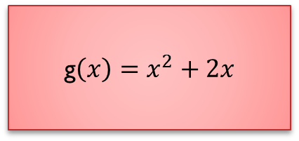
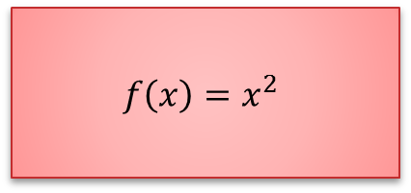
Function
function(math)
$$f\left(x\right)=x^{2}$$
7
49
g$\left(x\right)=x^{2}+2x$
3
15

Slide 4
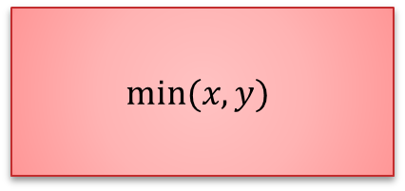
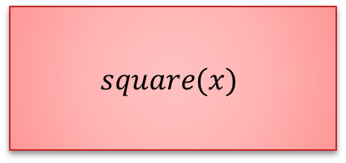
Function
function(C program)
$$square(x)$$
4
16
$$min⁡(x,y)$$
6,27
6

Slide 5
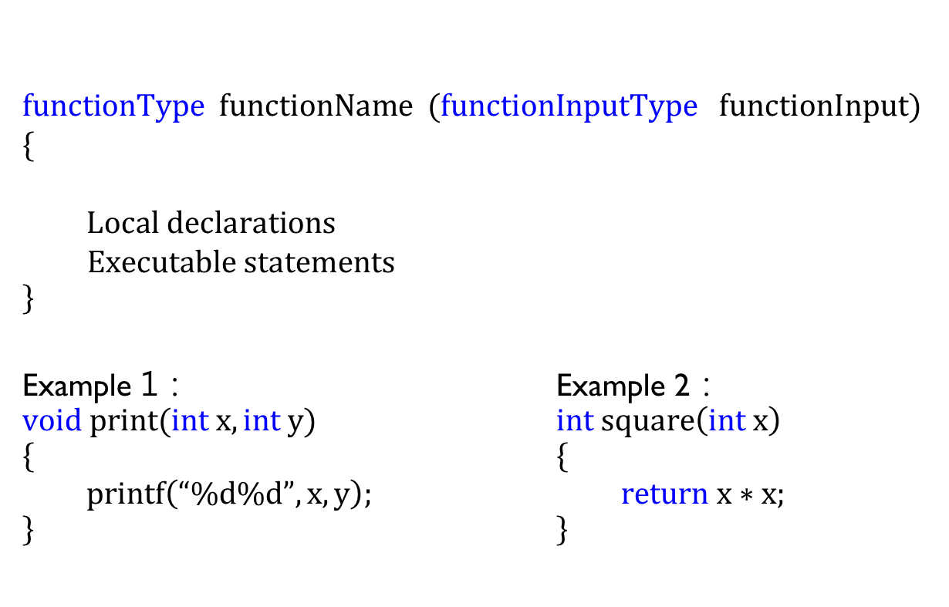
Function 的格式
data type
of return variable
$$functionType functionName (functionInputType functionInput) \\ \{$$
$Local declarations$ $$Executable statements \\ \}$$
Example 1： Example 2： $void print(int x,int y)$ $int square\left(int x\right)$ $\{$ $\{$ $printf\left(“\%d\%d”,x,y\right);$ $return x∗x;$ $\}$ $\}$
Function name
Data type of input
Input variable

Slide 6
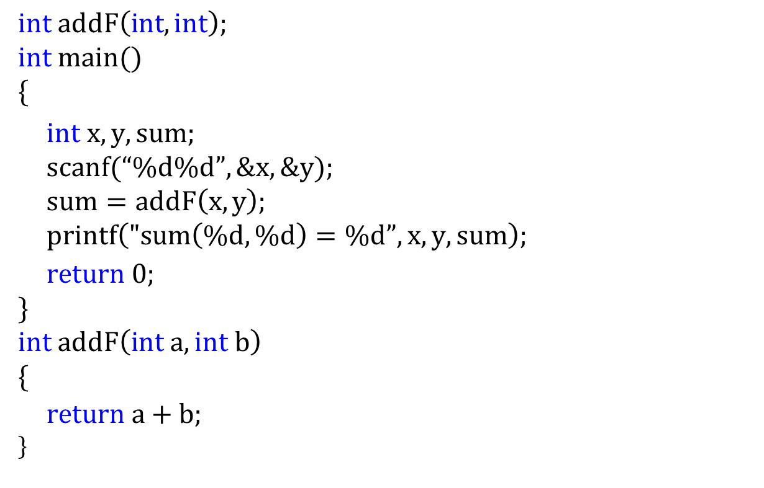


Function practice1-addition
$$int addF\left(int, int\right); \\ int main() \\ \{$$ $int x,y,sum;$ $scanf(“\%d\%d”,\&x,\&y);$ $sum=addF\left(x,y\right);$ $printf\left("sum\left(\%d,\%d\right)=\%d”,x,y,sum\right);$
$$return 0; \\ \} \\ int addF\left(int a, int b\right) \\ \{ \\ return a+b; \\ \}$$
x=5,y=10
$$addF\left(5,10\right)$$
x=5 ,y=10
10
$$addF\left(a=5,b=10\right)$$

Slide 7

Function practice2 - Minimum number
$$int min\left(int, int\right); \\ int main() \\ \{$$ $int x,y,m;$ … (1) $scanf(“\%d\%d”,\&x,\&y);$ … (2) $m=min\left(x,y\right);$ … (3) $printf(“min(\%d,\%d)=\%d”,x,y,m);$ … (5)
$$return 0; \\ \}$$
$$int min\left(int a, int b\right) …(4) \\ \{$$ $if\left(a<b\right)$
$$return a; \\ else \\ return b; \\ \}$$

Slide 8
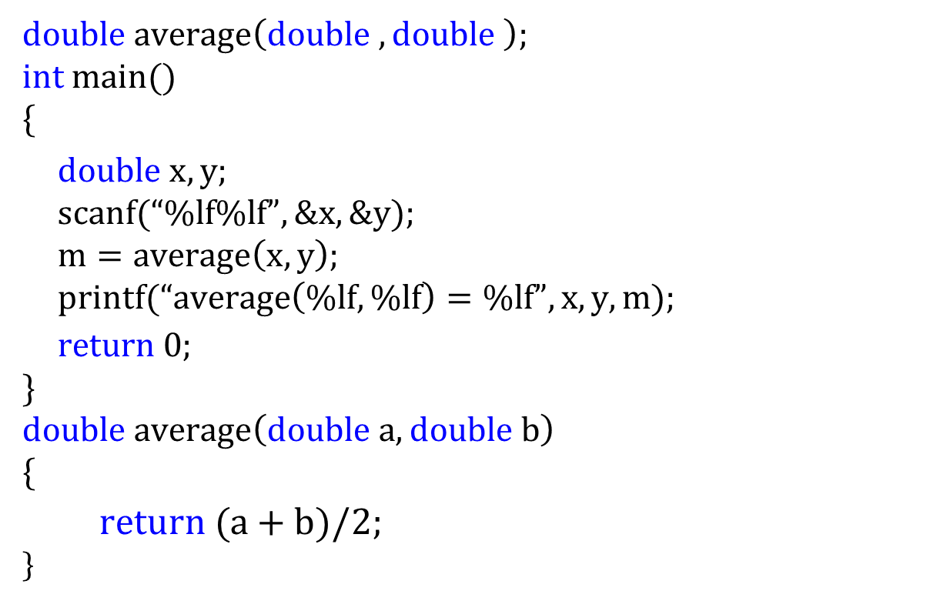
Function practice 3 - calculate average
$double average\left(double , double \right)$;
$$int main() \\ \{$$ $double x,y;$ $scanf(“\%lf\%lf”,\&x,\&y);$ $m=average\left(x,y\right);$ $printf(“average\left(\%lf,\%lf\right)=\%lf”,x,y,m);$
$$return 0; \\ \}$$
$$double average\left(double a, double b\right) \\ \{$$
$$return (a+b)/2; \\ \}$$

Slide 9
Function practice 3 - calculate average
$double average\left(double , double \right)$;
$$int main() \\ \{$$ $double x,y;$ $scanf(“\%lf\%lf”,\&x,\&y);$ $m=average\left(x,y\right);$ $printf(“average\left(\%lf,\%lf\right)=\%lf”,x,y,m);$
$$return 0; \\ \}$$
$$double average\left(double a, double b\right) \\ \{$$
$$return (a+b)/2; \\ \}$$

Slide 10
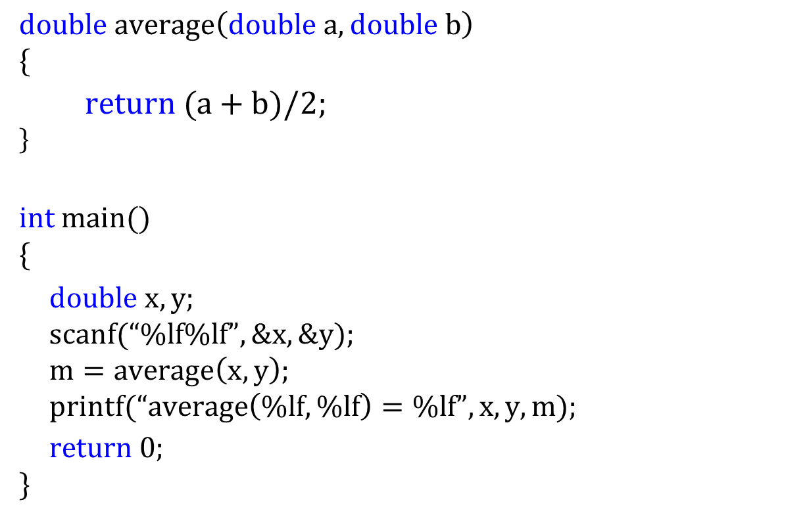
Function practice 3 - calculate average
$$double average\left(double a, double b\right) \\ \{$$
$$return (a+b)/2; \\ \}$$
$$int main() \\ \{$$ $double x,y;$ $scanf(“\%lf\%lf”,\&x,\&y);$ $m=average\left(x,y\right);$ $printf(“average\left(\%lf,\%lf\right)=\%lf”,x,y,m);$
$$return 0; \\ \}$$

Slide 11

Function practice 4- Printing a Countdown
$void print_count\left(int \right)$;
$$int main() \\ \{$$ $int i;$ $for \left(i=10;i>0;−−i\right)$ $print_count(i);$
$$return 0; \\ \}$$
$$void print_count\left(int a\right) \\ \{$$
$$printf ("\text{T} \text{minus}\text{ \%}\text{d} \text{and} \text{counting}\text{\backslash }\text{n}", n); \\ \}$$

Slide 12

Common mistakes
Function name, number of parameters, declare the data type of parameters, Definition is inconsistent with the call .
$void print_count\left(int , int\right)$;
$$int main() \\ \{$$ $int i;$ $for \left(i=10;i>0;−−i\right)$ $ans=print_count(i);$
$$return 0; \\ \}$$
$$void print_coungt\left(int a, int b\right) \\ \{$$
$$printf ("\text{T} \text{minus}\text{ \%}\text{d} \text{and} \text{counting}\text{\backslash }\text{n}", n); \\ \}$$

Slide 13

Common mistakes
2. Declare function but no return value, define return type is inconsistent with the declare type
3. Return multiple value in a function.
$$int addF\left(int, int\right); \\ int main() \\ \{$$ $int x,y,sum;$ $scanf(“\%d\%d”,\&x,\&y);$ $sum=addF\left(x,y\right);$ $printf\left("sum\left(\%d,\%d\right)=\%d”,x,y,sum\right);$
$$return 0; \\ \} \\ int addF\left(int a, int b\right) \\ \{$$ $return true;$ return a+b, a-b;
$$\}$$

Slide 14
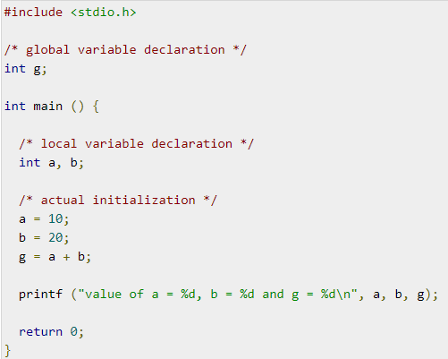
Use range of variables(Life cycle)
global variable： Can be used by every function.

Slide 15
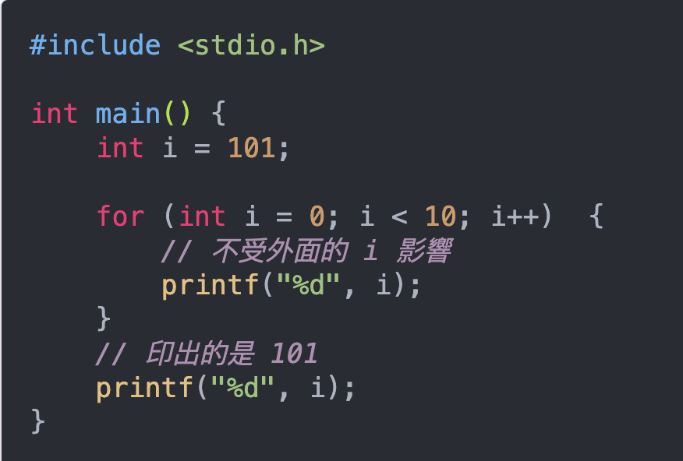
Use range of variables(Life cycle)
Local variable ： Can be used in a function only.
Block variable:
Can be used in a function only, for example for, while…
Local variable
block variable

Slide 16
Use range of variables(Life cycle)
static variable ：
Memory space is allocated and fixed at compile
time. Therefore, even if the function has the
initiative, static variable still can be save.

Slide 17
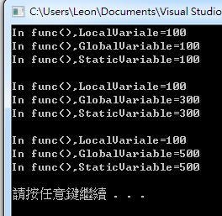
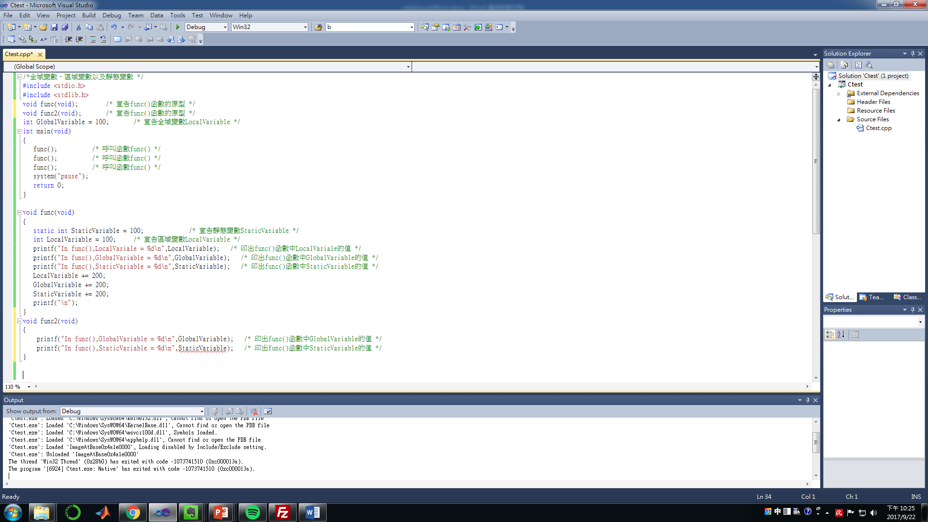
Example

Slide 18
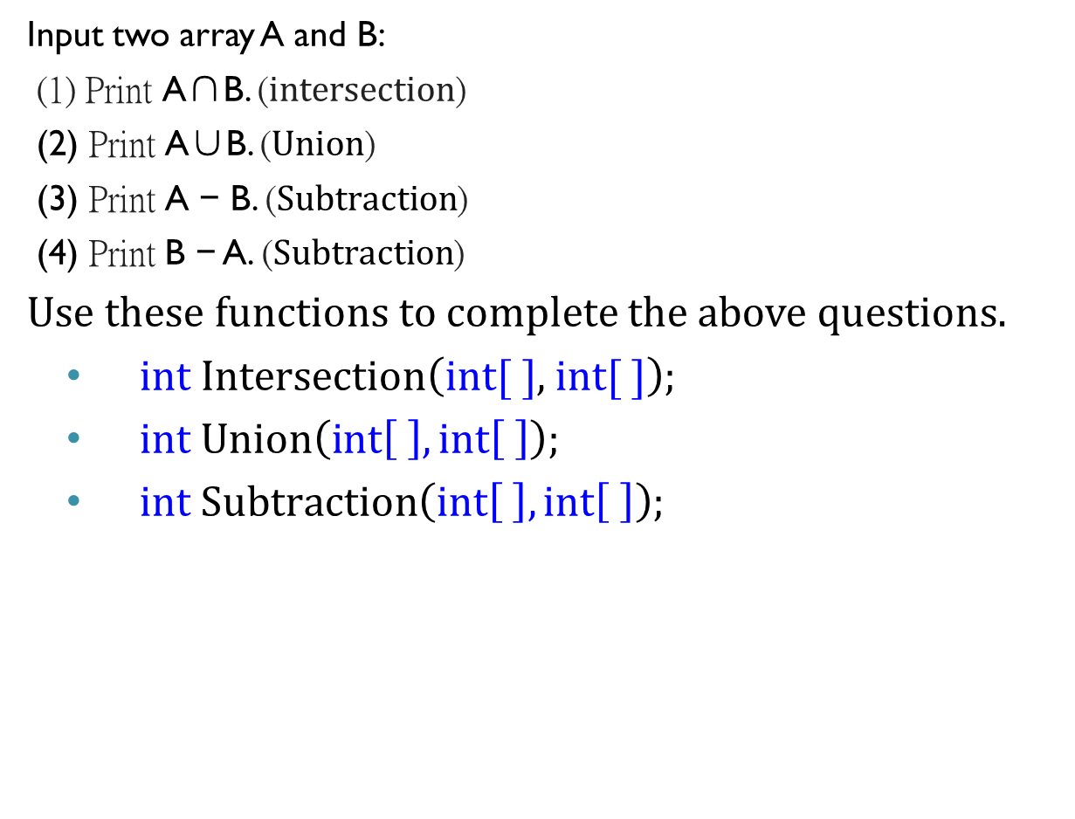
Exercise1:
Input two array A and B:
(1) Print A∩B. (intersection)
(2) Print A∪B. ($Union$)
(3) Print A − B. ($Subtraction$)
(4) Print B − A. ($Subtraction$)
Use these functions to complete the above questions.
$int Intersection\left(int\text{[ ]}\text{, }int[ ]\right);$
$int Union\left(int\left[ \right],int\left[ \right]\right);$
$int Subtraction\left(int\left[ \right],int\left[ \right]\right);$

Slide 19
Exercise1:
The order of the output don’t need to be the same as the testing output.
Testing data 1:
A = [ 1,2,6,7,8,11,12,13,14,15]
B = [ 1,2,3,4,7,9,11,13,19,20]
Testing output:
A∩B = 1,2,7,11,13
A∪B = 1,2,3,4,6,7,8,9,11,12,13,14,15,19,20
A − B = 6,8,12,14,15
B − A = 3,4,9,19,20
Testing data 2:
A = [ 1,3,5,7,9,11,13,15,17,19]
B = [ 2,4,6,8,10,12,14,16,18,20]
Testing output:
A∩B =
A∪B = 1,2,3,4,5,6,7,8,9,10,11,12,13,14,15,16,17,18,19,20
A − B = 1,3,5,7,9,11,13,15,17,19
B − A = 2,4,6,8,10,12,14,16,18,20

Slide 20
Exercise1:
Testing data 3:
A = [ 1,1,1,2,3,5,7,8,11,11]
B = [ 1,3,3,3,3,4,7,7,13,19]
Testing output:
A∩B = 1,3,7
A∪B = 1,2,3,4,5,7,8,11,13,19
A − B = 2,5,8,11
B − A = 4,13,19
Testing data 4:
A = [2,2,2,4,4,4,6,6,6,8]
B = [1,1,1,3,3,3,5,5,5,7]
Testing output:
A∩B =
A∪B = 1,2,3,4,5,6,7,8
A − B = 2,4,6,8
B − A = 1,3,5,7

